Slide 1
Flow Cell Design for Microfluidic flow Study
Presenter: Nisarg Makwana[201582552] Project Supervisor: Prof. Nik Kapur

Slide 2
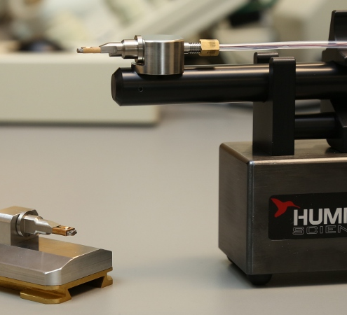
Summary
Aim & project objectives
Introduction to flow cell
Flow properties
Numerical model study
Design study
Result & verification
Prospective work

Slide 3
AIM
PROJECT OBJECTIVES
The aim of this project is to design flow cell geometry to obtain thorough & rapid mixing of continuous microfluidic flow and understand flow pattern for device used to study in image spectroscopy using TEM(Transmission Electron Microscope).
Literature review
Building CAD geometry
Developing mixing design for external turbulence
Performing parametric tests and result visualization
Testing of modified geometrical model to analyze the performance
Suggest new potential designs to improve performance.

Slide 4
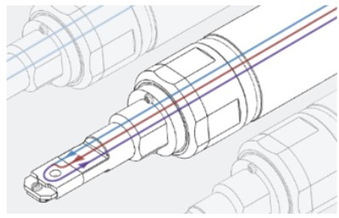
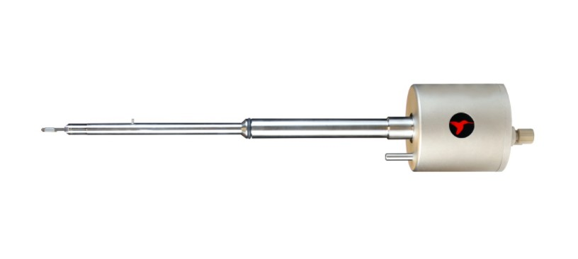
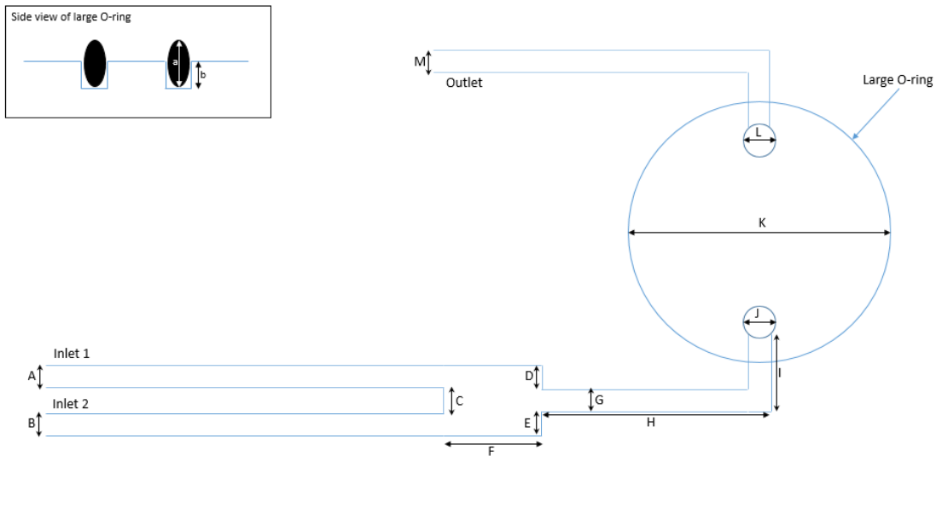
Flow Cell
Fig1. Practical Flow Cell Image[2]
What is Microfluidics?
Flow cell are devices in which liquid samples can be continuously flowed for spectrometry study.
Flow cells can either be purpose-built for the sensor of interest or sensors be developed for use with a commercially available flow cell [1].
Fig2. Schematic design of flow cell by Humming bird Scientific

Slide 5
Application of Flow Cell
Clinical diagnostics
Food analysis
Detecting pathogenic bacteria
Detection of explosives
Materials characterization study

Slide 6
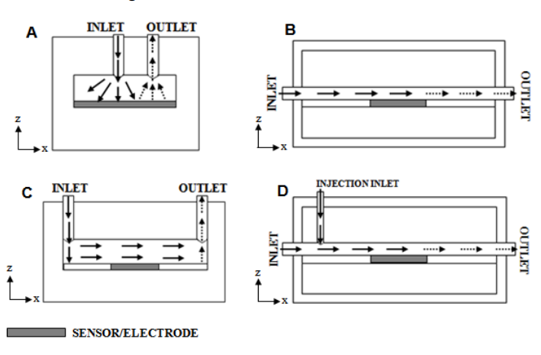
Typical Designs of Flow Cell
Flow cells have vast array of designs, but four most common systems include[2]
Impinging jet directly onto the sensor surface.
Channel flow with embedded sensor.
Impinging jet delivering with channel flow over embedded sensor.
Injection into a flowing carrier channel flow.
Fig3. Schematic plan view of laminar flow in an open channel[2]

Slide 7
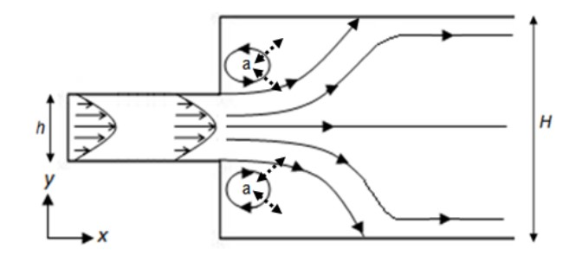

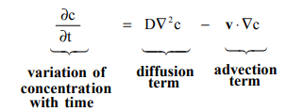
Flow Properties
Closed edge eddies
Fig4 : Formation of edge eddies in expanded tube flow[2]
Governing Equations
Advection Diffusion Equation
3D Navier-Stokes Equation
Flow is Laminar, Incompressible
Any flow with Reynolds number <=2000 is Laminar.
For study Re=1
Volumetric flow rate= 0.1-5 mL/min, For study, 1mL/min flow rate is taken
Physical properties of fluid is of Water
Diffusion coefficient is 5e-10 m^2/s

Slide 8

Numerical ModeL Study
Geometrical Modelling
Base model
Physical Model
Laminar flow(spf) model
Flow Study
Mesh convergence study
Reacting flow, Diluted species(rfd1)
Dimensions provided by Hummingbird Scientific
Results Visualization
Velocity profile
Concentration profile
Pressure drop maps
Outlet concentration patterns
Mixing index calculation
Peclet number determination
Transport of diluted species(tds) model
Time-Dependent study
Stationary study
Equation to Calculate flow variance[5]

Slide 9
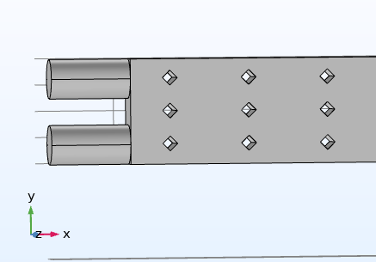
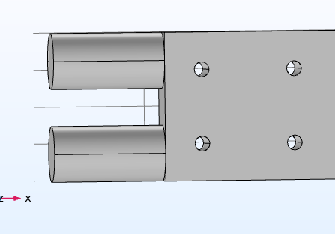
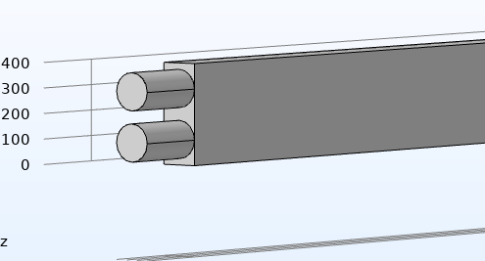
Design Implementations
Change in distance between inlets
Adding cylindrical blocks barriers in mixing tube.
Adding square blocks barriers in mixing tube.
Adding parallelogram barriers in mixing tube.
Implementing 3D zig zag mixer geometry.

Slide 10
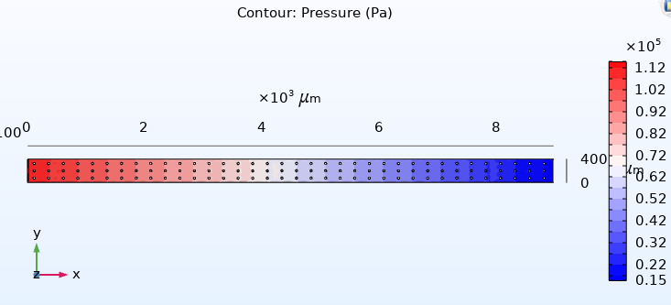

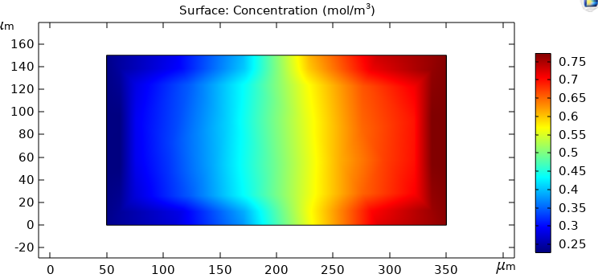
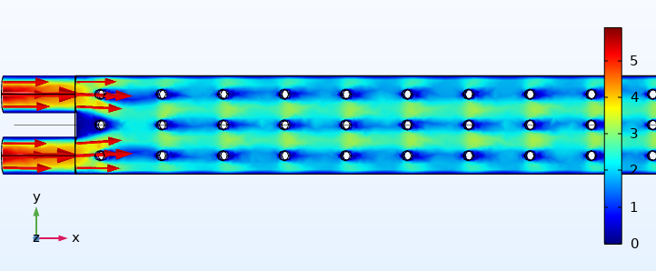

Results
For the base Geometry, To understand flow following results are of interest.
Velocity profile
Concentration profile
Pressure drop maps
Outlet concentration patterns
Mixing index calculation
Distance/Peclet number [ ]
Fig5. Pressure drop profile
Eddies Formation
Fig7. Outlet concentration profile
Fig6. Velocity profile

Slide 11
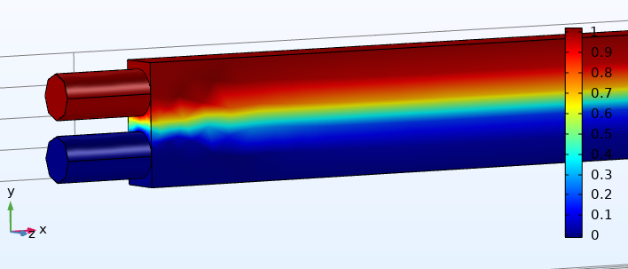
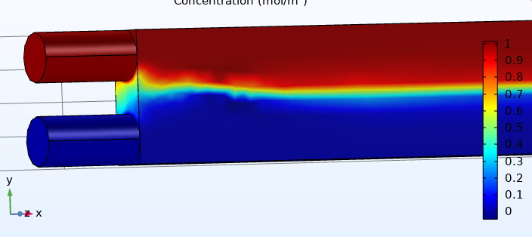
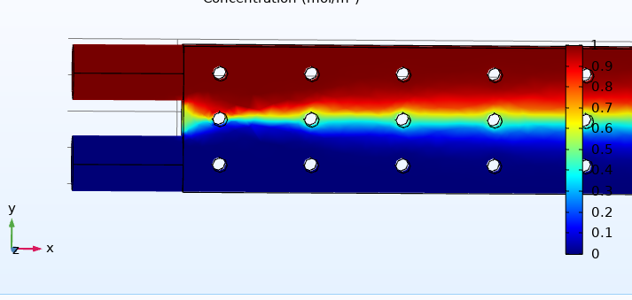
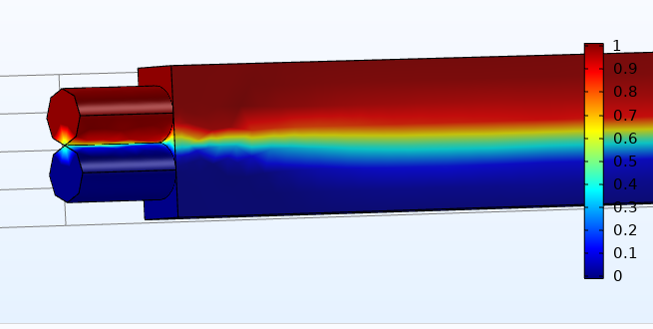
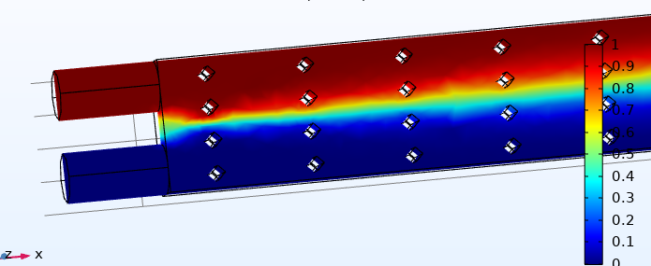
Results
Fig9. Concentration map for Base design with 50 mm distance between inlets
Fig7. Concentration map for Base design
Fig10. Concentration map for Base design with Cylindrical block barriers in flow
Fig8. Concentration map for Base design with 0 mm distance between inlets
Fig11. Concentration map for base design with Square block barriers in flow

Slide 12
Result Verification
Geometrical Design | Mixing Index
Hummingbird base design | 0.44346
Distance between inlet 100mm | 0.47399
Distance between inlet 0mm | 0.51678
Distance between inlet 50mm | 0.43592
Cylindrical block barriers in mixing tube | 0.52346
Square block barriers in mixing tube | 0.56045
Perpendicular fins in mixing tube | 0.32159
Replicating results in laboratory.
By predicting mixing by pressure drop data in device.
By comparison of concentration maps with the work of Li-Yu Tseng in 2011[4].
Verifying mixing index with that of Hummingbird Corporation’s study.

Slide 13
Prospective work
Generate concentration profile by use of Parallelogram barriers in mixing tube
Implementation of a hybrid mixing system of both passive and active methods (Example : Pulsating inlet flow.)
Generating time dependent concentration maps profiles of modified design
Implementing peclet number calculation to understand flow pattern with respect to flow rate(Tentative).

Slide 14
Questions answered
what are the scales on the geometry in the figures shown?
The geometry provided here is in micrometer scale where the length of channel is 9mm in the first design but for others, length Is provided in the report. To achieve proper mixing for same length designs are build with passive mixers implemented.
Slide 7 says mL/Min, whereas we run in uL/min. Not sure if this was a formatting error?
From the research work referred in the report and the initial values provided by professor nik. The flow rate value ranged between 0.1 to 10 ml/min therefore appropriate initial values were taken.

Slide 15
Works cited
Rippeth, J.J.; Gibson, T.D.; Hart, J.P.; Hartley, I.C.; Nelson, G. Flow-injection detector incorporating a screen-printed disposable amperometric biosensor for monitoring organophosphate pesticides. Analyst 1997, 122, 1425–1429.
Anon 2022. Overview | Hummingbird Scientific. Hummingbird Scientific. [Online]. [Accessed 15 February 2022]. Available from: https://hummingbirdscientific.com/products/liquid/#.
Pike, D., Kapur, N., Millner, P. and Stewart, D. 2012. Flow Cell Design for Effective Biosensing. Sensors. 13(1),pp.58-70.
Li-Yu Tseng, An-Shik Yang, Chun-Ying Lee & Chang-Yu Hsieh (2011) CFD-Based Optimization of a Diamond-Obstacles Inserted Micromixer with Boundary Protrusions, Engineering Applications of Computational Fluid Mechanics, 5:2, 210-222, DOI: 10.1080/19942060.2011.11015365.
Finlayson, Bruce & Aditya, Andy & Brasher, Vann & Dahl, Lisa & Dinh, Ha & Field, Adam & Flynn, Jordan & Jenssen, Curtis & Kress, Daniel & Moon, Anna & Ninh, Francis & Nordmeier, Andrew. (Jan 2008), Mixing of Liquids in Microfluidic Devices. Pg, 2.

Slide 16
Thanks You
For
Listening

